Slide 3
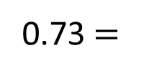
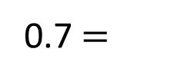
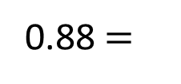
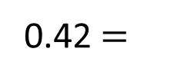
T | O | tth | hth | thth
1) What number is represented in the place value chart? Write it in words and numerals.
Write each decimal as a fraction.
3) What is the value of the digit 6? 41.986
0.7 $=$
0.73 $=$
0.42 $=$
0.88 $=$

Slide 4







T | O | tth | hth | thth
1) What number is represented in the place value chart? Write it in words and numerals.
Write each decimal as a fraction.
3) What is the value of the digit 6? 41.986
0.243
Two hundred and forty three thousandths
$\frac{\text{7}}{\text{10}}$
$\frac{\text{73}}{\text{100}}$
0.7 $=$
0.73 $=$
0.42 $=$
$\frac{\text{42}}{\text{100}}$
$=$ $\frac{\text{21}}{\text{50}}$
0.88 $=$
$\frac{\text{88}}{\text{100}}$
$=$ $\frac{\text{44}}{\text{50}}$
$=$ $\frac{\text{2}\text{2}}{\text{25}}$
6 thousandths

Slide 6
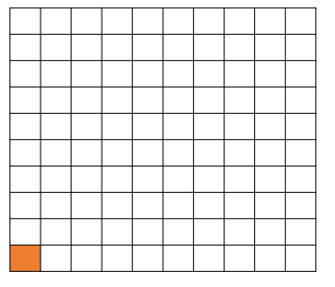
one hundredth
one out of 100
$\frac{\text{1}}{\text{100}}$
zero point zero one
0.01

Slide 7

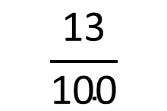

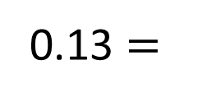
$$\frac{\text{13}}{\text{50}}$$
Have a think
Is this 0.13 as a decimal?
$$\frac{\text{13}}{\text{100}}$$
0.13 $=$
$×$ 2
$\frac{\text{13}}{\text{50}}$
$=$ $\frac{\text{26}}{\text{100}}$
$=$ $\frac{}{\text{100}}$
$=$ 0.26
$×$ 2

Slide 8
Find the equivalent decimals for these fractions.
$×$ 50
$×$ 5
$\frac{\text{1}}{\text{2}}$
$\frac{\text{50}}{\text{100}}$
$\frac{\text{9}}{\text{20}}$
$\frac{\text{45}}{\text{100}}$
0.5
0
0.45
$×$ 50
$×$ 5
$÷$ 2
$\frac{\text{82}}{\text{200}}$
$\frac{\text{41}}{\text{100}}$
0.41
$÷$2
Have a think

Slide 9
Have a go at questions 1 - 3 on the worksheet

Slide 10
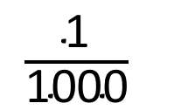
$\frac{\text{1}}{\text{1000}}$
$$=$$
0.001

Slide 11
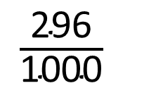
What fraction of the square has been shaded?
Write the fraction as a decimal.
$\frac{\text{296}}{\text{1000}}$
0.296
Have a think

Slide 12
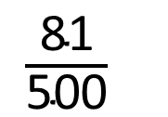
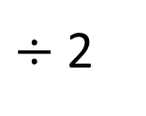
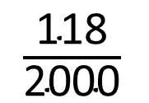
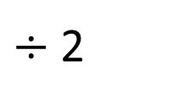
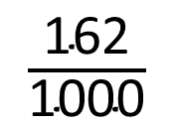
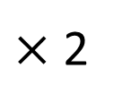
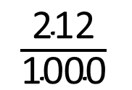
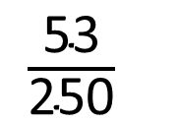
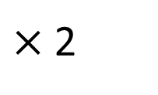
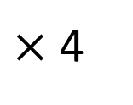
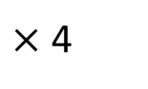
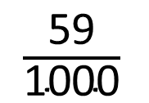
Find the equivalent decimals for these fractions.
$×$ 4
$÷$ 2
$\frac{\text{53}}{\text{250}}$
$\frac{\text{212}}{\text{1000}}$
$\frac{\text{118}}{\text{2000}}$
$\frac{\text{59}}{\text{1000}}$
0.212
0.059
$×$ 4
$×$ 2
$÷$ 2
$\frac{\text{81}}{\text{500}}$
$\frac{\text{162}}{\text{1000}}$
0.162
$×$2
Have a think

Slide 13
Have a go at question 4 on the worksheet

Slide 14


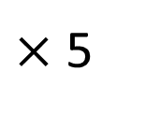
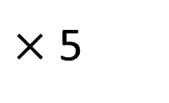
$$\frac{\text{1}}{\text{10}}$$
0.1 | 0.1 | 0.1 | 0.1 | 0.1 | 0.1 | 0.1 | 0.1 | 0.1 | 0.1
0.05 | 0.05 | 0.05 | 0.05 | 0.05 | 0.05 | 0.05 | 0.05 | 0.05 | 0.05 | 0.05 | 0.05 | 0.05 | 0.05 | 0.05 | 0.05 | 0.05 | 0.05 | 0.05 | 0.05
$×$ 5
$$\frac{\text{1}}{\text{20}}$$
$=$ 0.05
$\frac{\text{1}}{\text{20}}$
$\frac{\text{5}}{\text{100}}$
0.05
$×$ 5

Slide 15
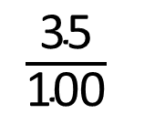
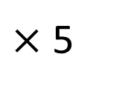
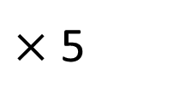

Find the equivalent decimal for $\frac{\text{7}}{\text{20}}$
0.1 | 0.1 | 0.1 | 0.1 | 0.1 | 0.1 | 0.1 | 0.1 | 0.1 | 0.1
0.05 | 0.05 | 0.05 | 0.05 | 0.05 | 0.05 | 0.05 | 0.05 | 0.05 | 0.05 | 0.05 | 0.05 | 0.05 | 0.05 | 0.05 | 0.05 | 0.05 | 0.05 | 0.05 | 0.05
0.05 | 0.05 | 0.05 | 0.05 | 0.05 | 0.05 | 0.05 | 0.05 | 0.05 | 0.05 | 0.05 | 0.05 | 0.05 | 0.05 | 0.05 | 0.05 | 0.05 | 0.05 | 0.05 | 0.05
0.35
$×$ 5
$\frac{\text{7}}{\text{20}}$
$\frac{\text{35}}{\text{100}}$
0.35
$×$ 5
Have a think

Slide 16

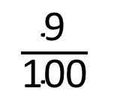
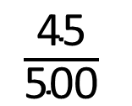
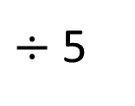

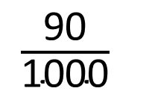
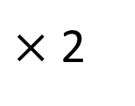
Find the equivalent decimal for $\frac{\text{45}}{\text{500}}$
Is there more than one way?
$÷$ 5
$×$ 2
$\frac{\text{9}}{\text{100}}$
$\frac{\text{45}}{\text{500}}$
$\frac{\text{90}}{\text{1000}}$
0.09
0.09
0
$÷$ 5
$×$ 2
Have a think

Slide 17
Have a go at the rest of the questions on the worksheet

