Slide 1
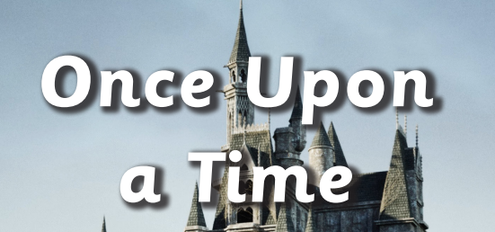
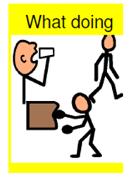
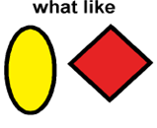
Colourful Semantics and Word Aware

Slide 2
pigs
old man
beanstalk
old woman
house
cottage

Slide 3
turnip
dog
mouse
girl
cat
caravan

Slide 4
sweets
dog
witch
girl
oven
breadcrumbs

Slide 5
market
sticks
cow
bricks
straw
fox

Slide 6
Goldilocks
baby bear
Hansel
mummy bear
Gretel
daddy bear

Slide 7
Jack
baby bear
Giant
mummy bear
Gingerbread Man
daddy bear

Slide 8
witch
boy
old man
girl
old woman
daddy bear

Slide 9
pulling
following
eating
climbing
walking
planting

Slide 10
blowing
swimming
building
climbing
running
planting

Slide 11
scary
small
delicious
big
evil
enormous

Slide 12
naughty
soft
cold
hard
hot
enormous

