Slide 1
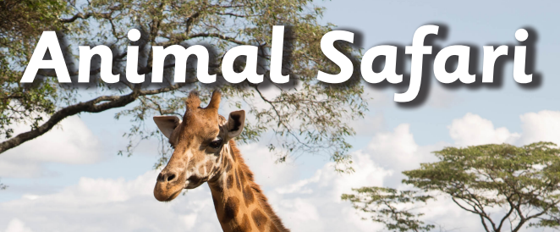
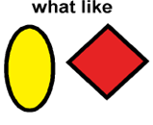
Colourful Semantics and Word Aware

Slide 2
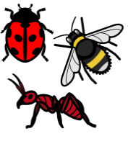
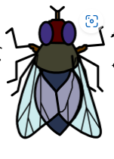
spider
insect
bee
wasp
fly
butterfly

Slide 3
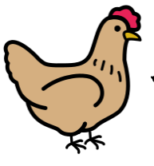
caterpillar
chick
ladybird
chicken
lion
egg

Slide 4
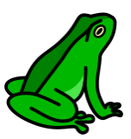
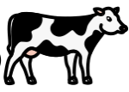
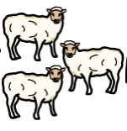
frog
cow
tadpole
sheep
frogspawn
horse

Slide 5
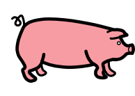
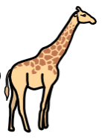
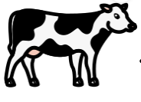
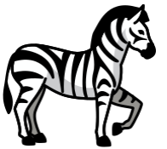
pig
giraffe
cow
monkey
duck
zebra

Slide 6
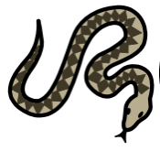
snake
fish
elephant
octopus
tiger
shark

Slide 7
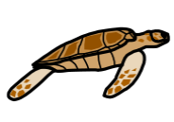
dolphin
seahorse
starfish
shell
jellyfish
turtle

Slide 8
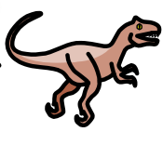
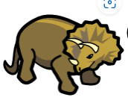
stegosaurus
velociraptor
tyrannosaurus
pterodactyl
triceratops
diplodocus

Slide 9
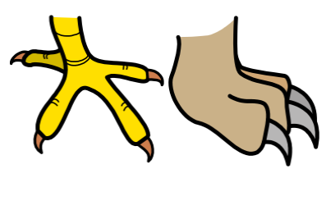
claws
scales
tail
horns
teeth
fur

Slide 10
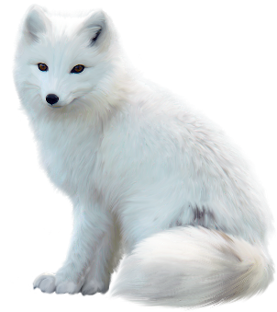
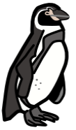
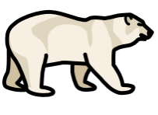
jungle
arctic fox
penguin
ladybird
polar bear
paws

Slide 11
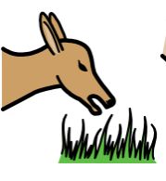
running
climbing
eating
playing
biting
chasing

Slide 12
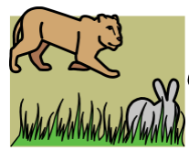
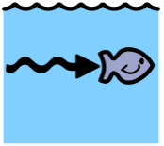
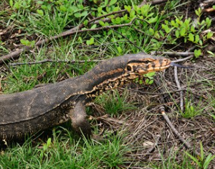
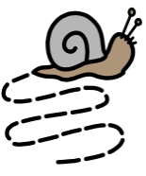
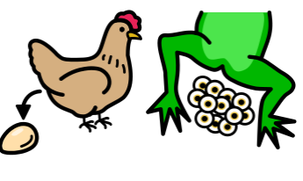
hunting
swimming
scuttling
flying
crawling
laying

Slide 13
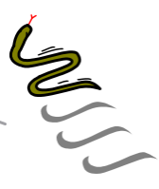
scratching
sleeping
slithering
fighting
relaxing
stomping

Slide 14
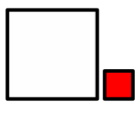
scary
tiny
big
dangerous
small
long

Slide 15
long
slow
short
spikey
fast
stripey

Slide 16
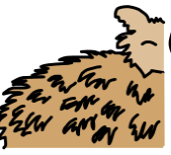
spotty
furry
smooth
fierce
rough
cute

Slide 17
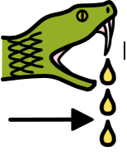
powerful
beautiful
colourful
feathered
venomous

